Slide 1
TreeAge workbench

Slide 2
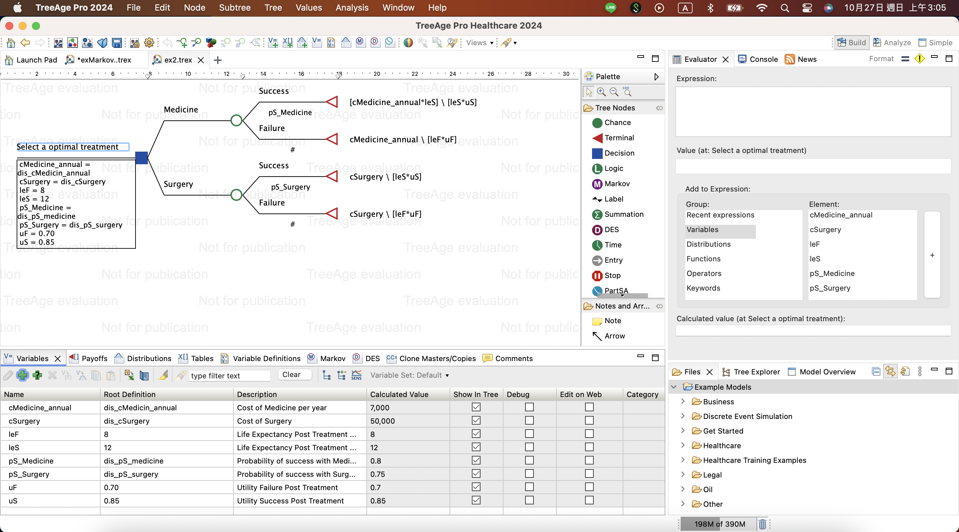
Workbench
Tree editor
View
Project View , Model Validation
And Model Overview

Slide 3
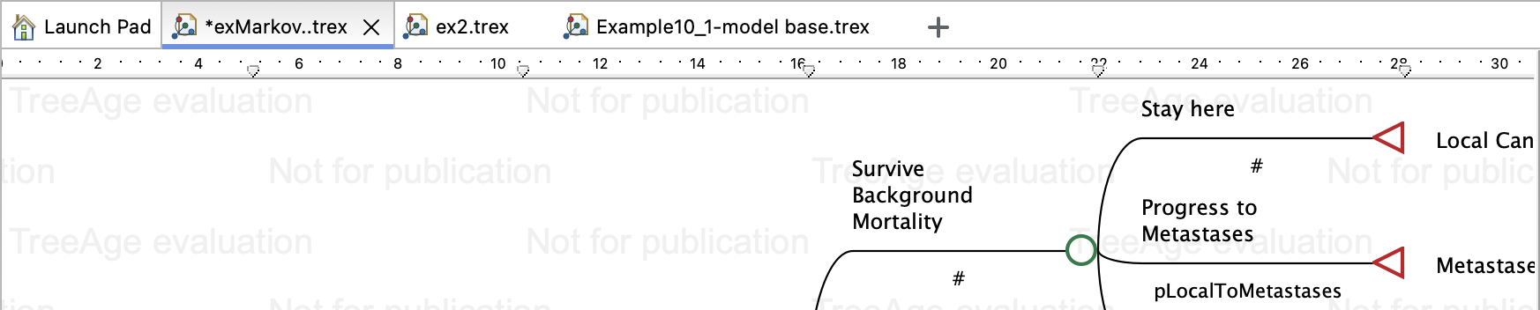
Workbench-Tree Diagram Editor
You can open multiple Tree Diagram Editors to edit multiple models. You can also open multiple synchronized editors for the same model. When multiple editor windows are open, the inactive windows will appear as tabs at the top of the active window.

Slide 4
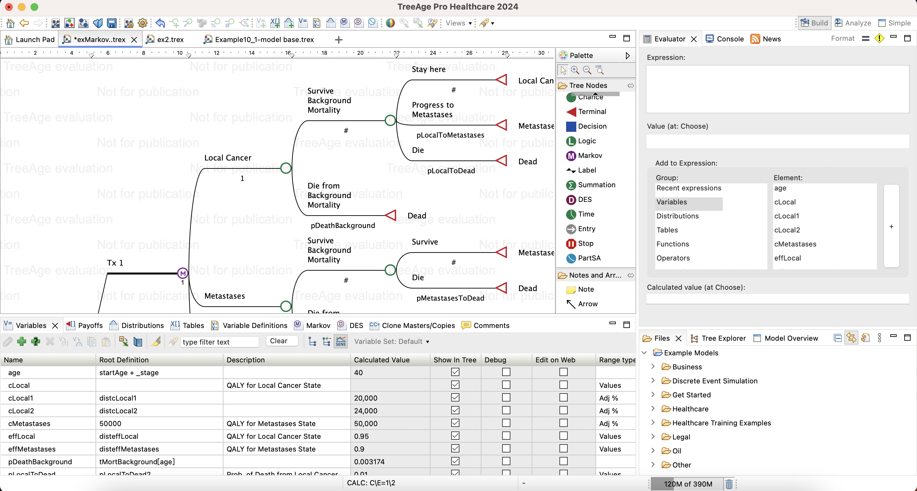
Workbench
Use the arrows between panes to re-size editors and views.

Slide 5
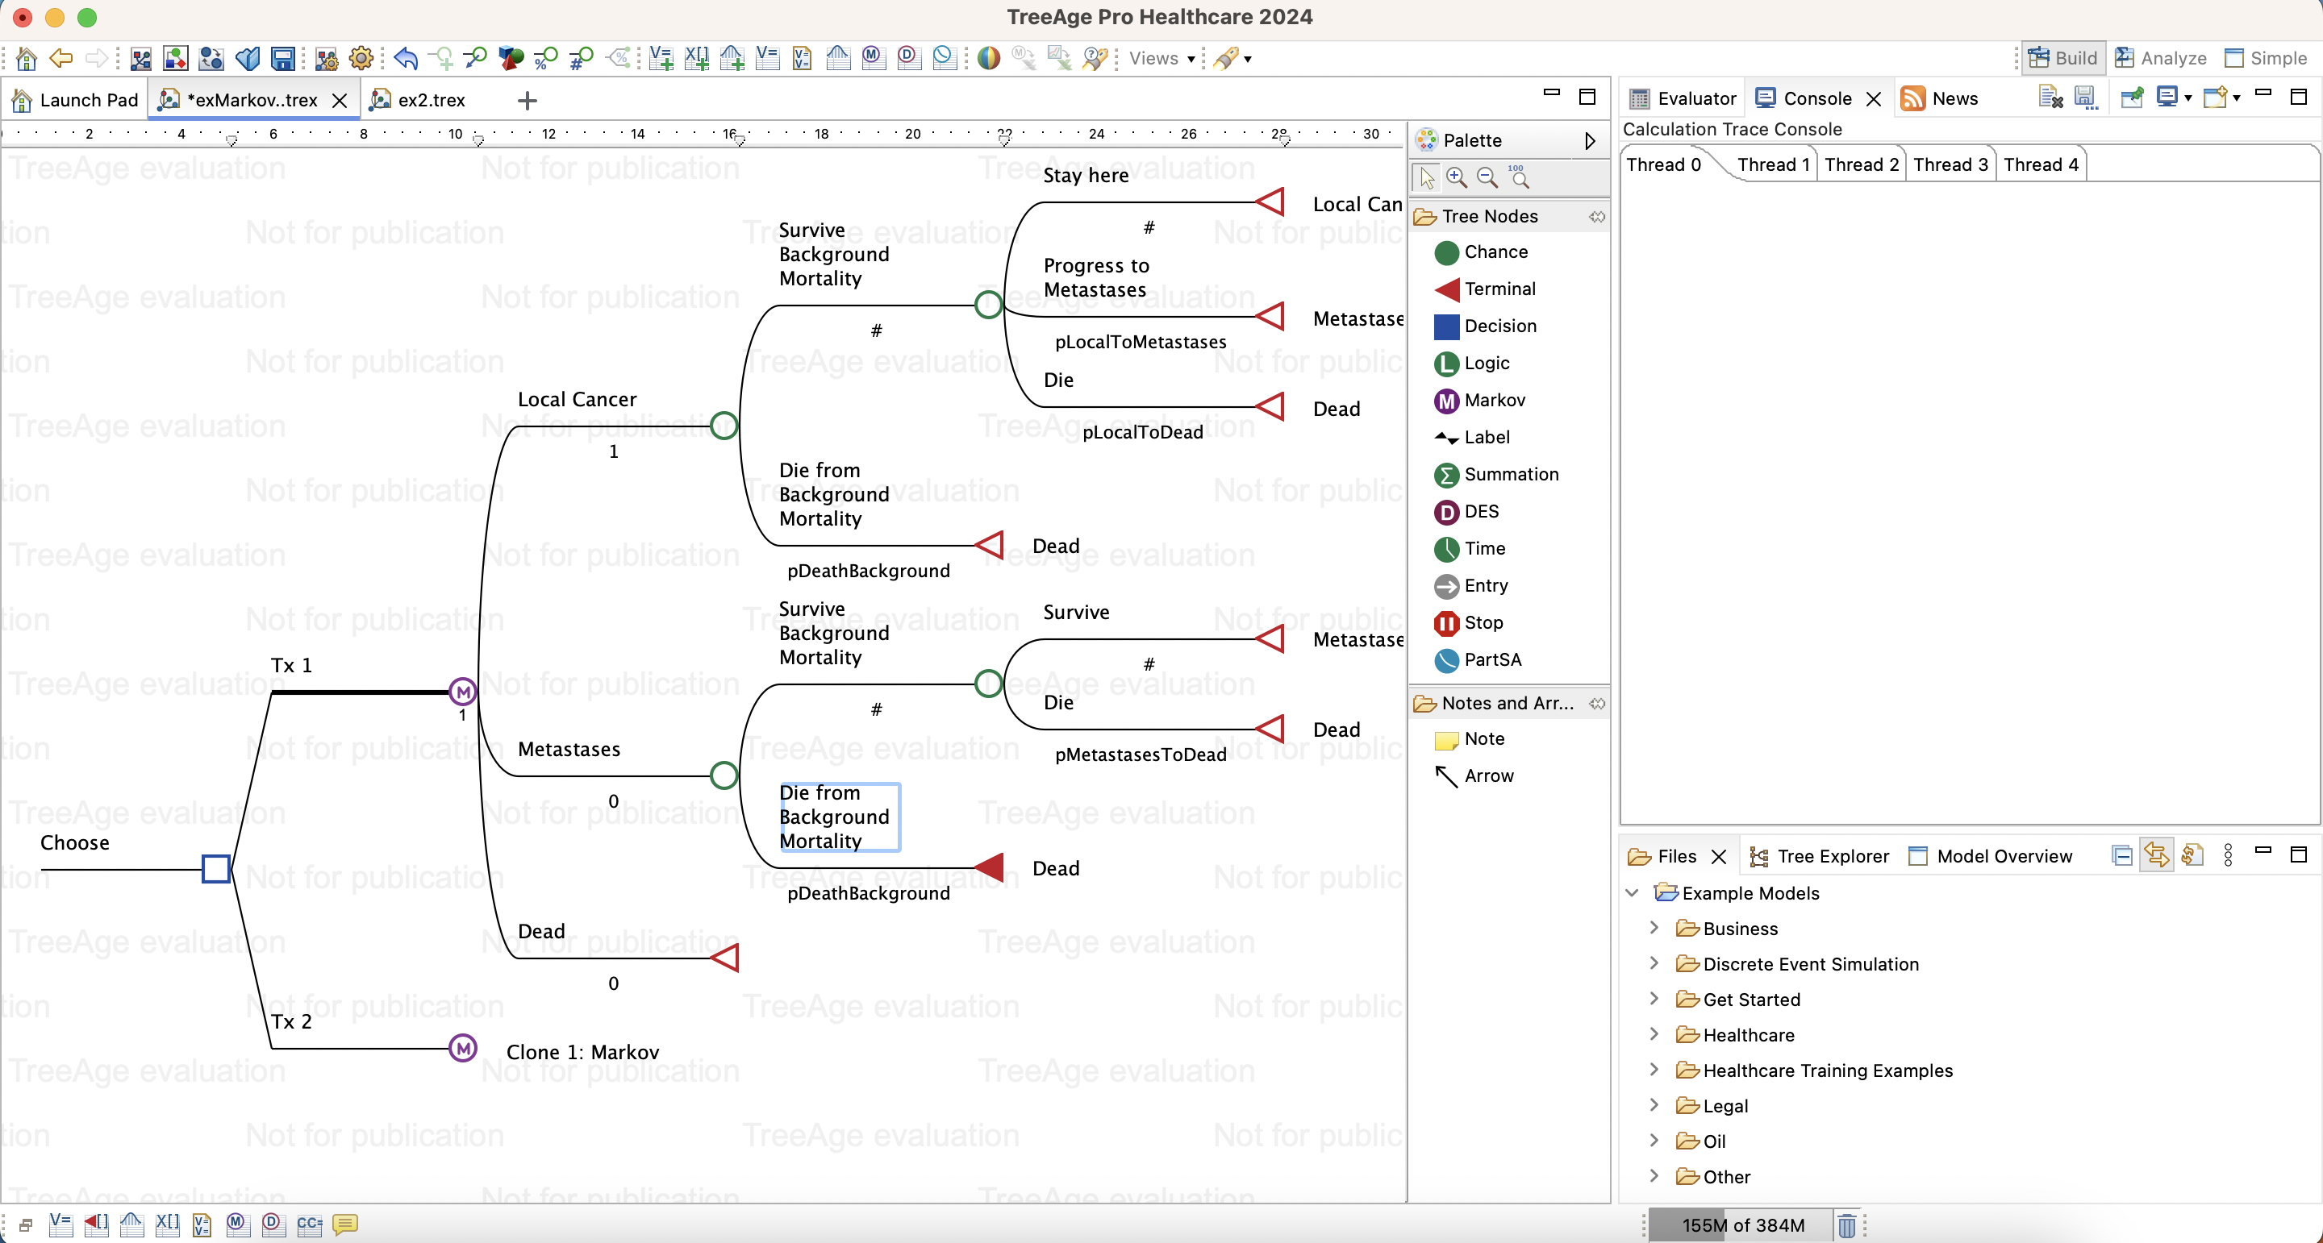
Workbench
minimize
Restore one or all

Slide 6
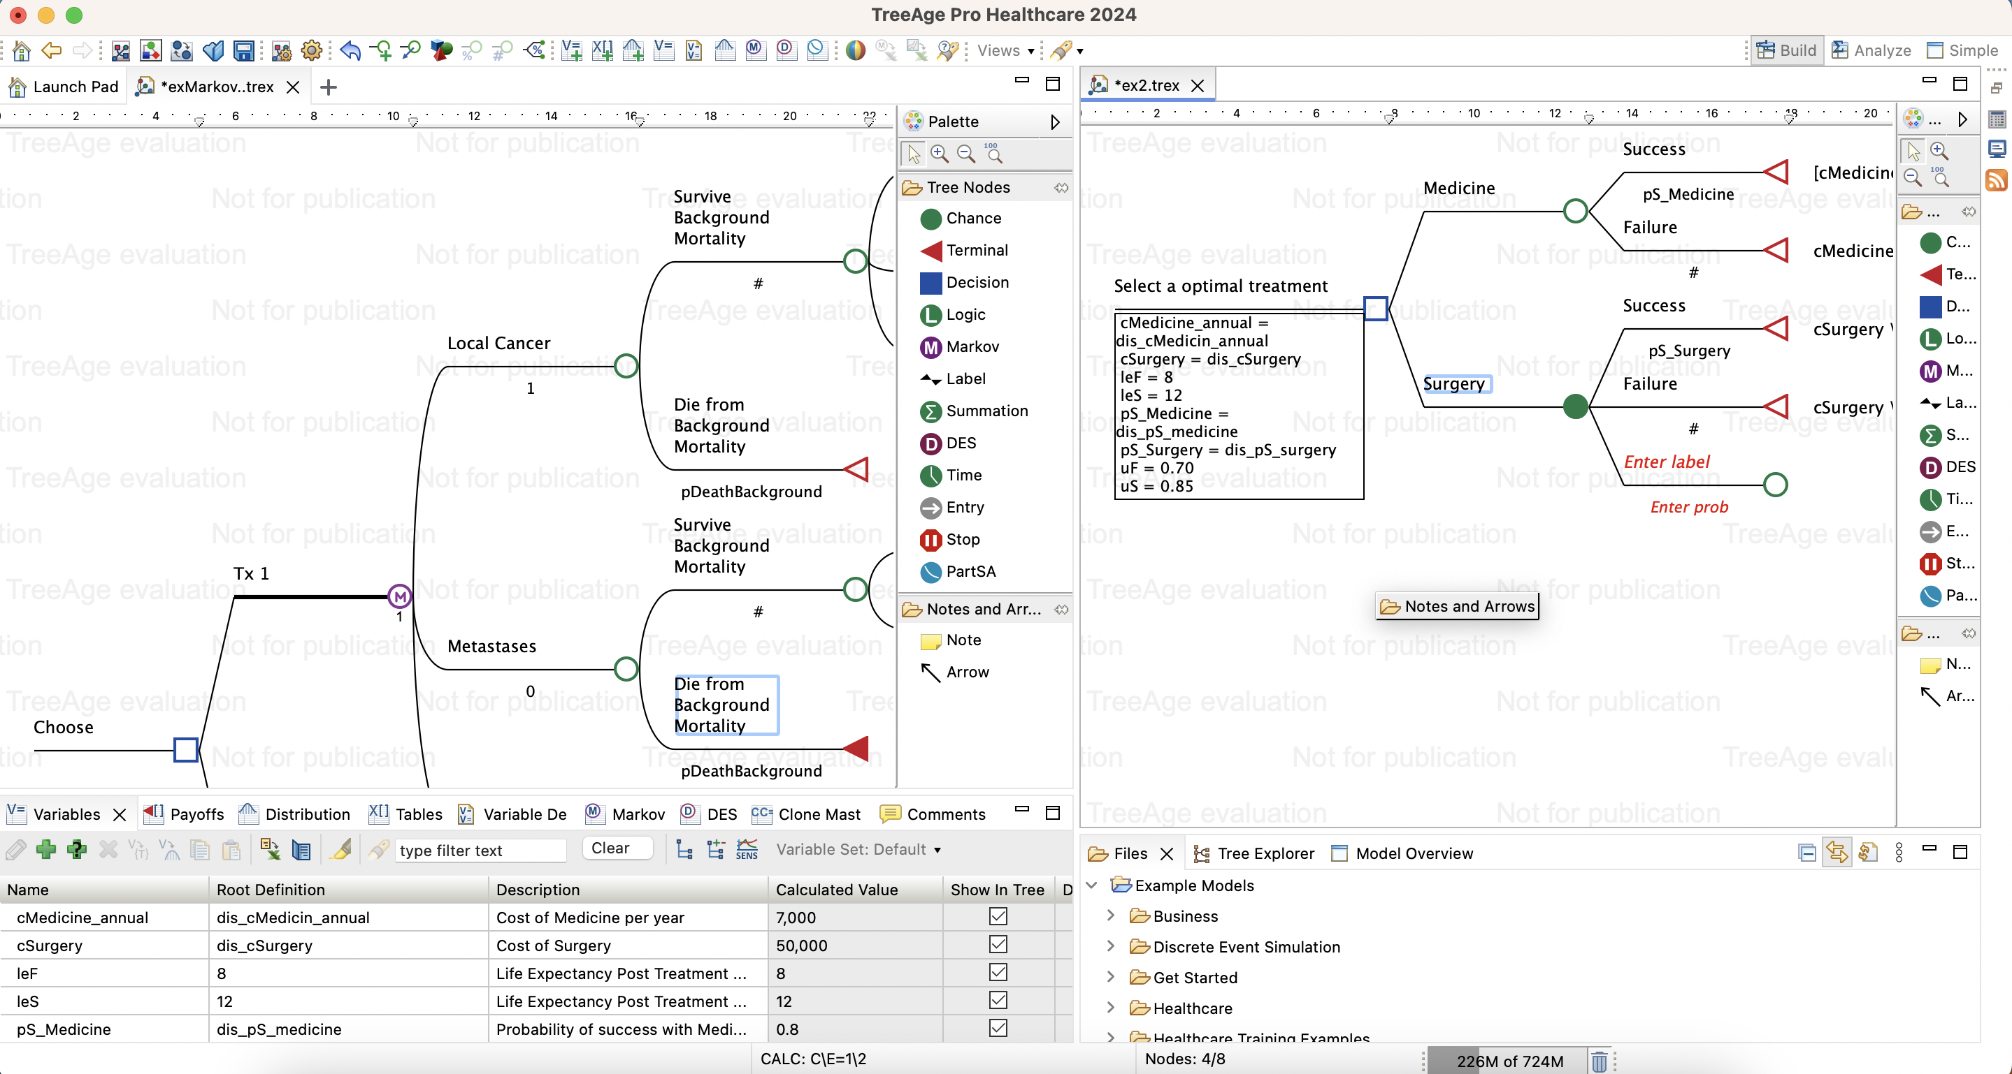
Workbench
Split the Tree Editor to look at two models (or outputs) side by side.
- Click on a Tree Editor pane tab and hold down the mouse button. - Drag the tab to the left, right, top, or bottom of the Tree Editor pane.
- A bold line will appear down the center of the Tree Editor. Release the mouse button and the moved tab will appear in a separate section or the Tree Editor pane.
- To move back, click and drag the tab back to its original location.

Slide 7
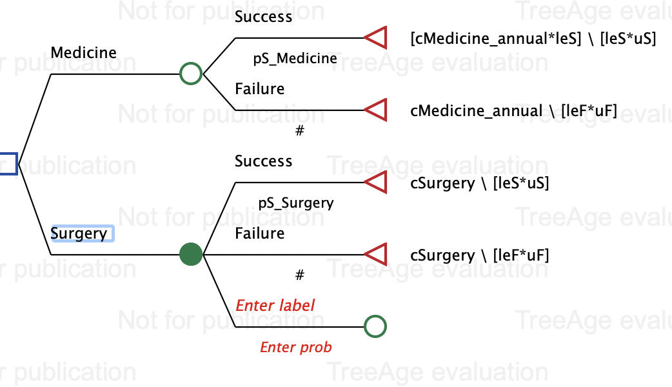
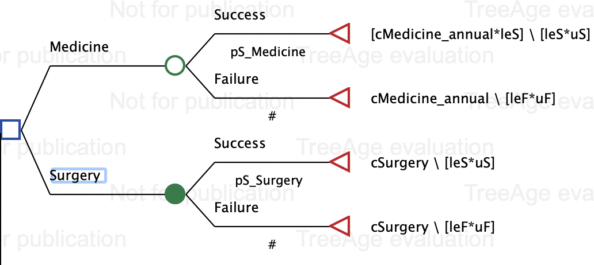
Workbench
點兩下新增

Slide 8

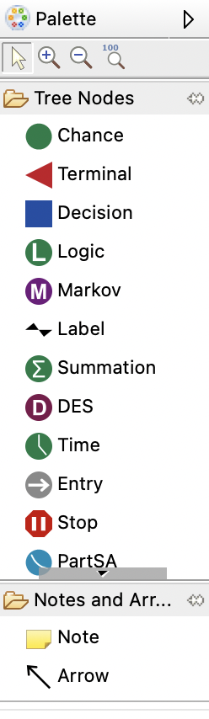



Node Types
- Point where a choice must be made from the options available
- Point where there are two or more possible event outcomes
- non-Markov: End point for a scenario within the model
-Markov: End point for a cycle
- Indicates the start of Markov model

Slide 9




Node Types
• Like a chance node but with logical expressions(true/false)instead of probabilities
• Expressions checked from top down until one is true
• Discrete Event Simulation (DES) or Time-to-Event Models
• Partitioned Survival Model
• The trial reaches to the Stop Node , they will not immediately finished to the end of the cycle but will wait until other trials finish the cycle.

Slide 10
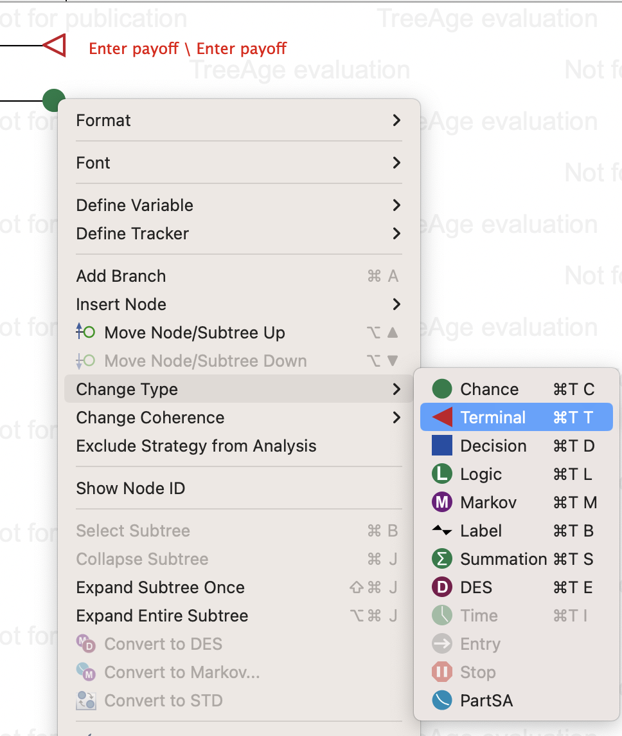
Change Node Types
按住Node/右鍵/Change Type

Slide 11
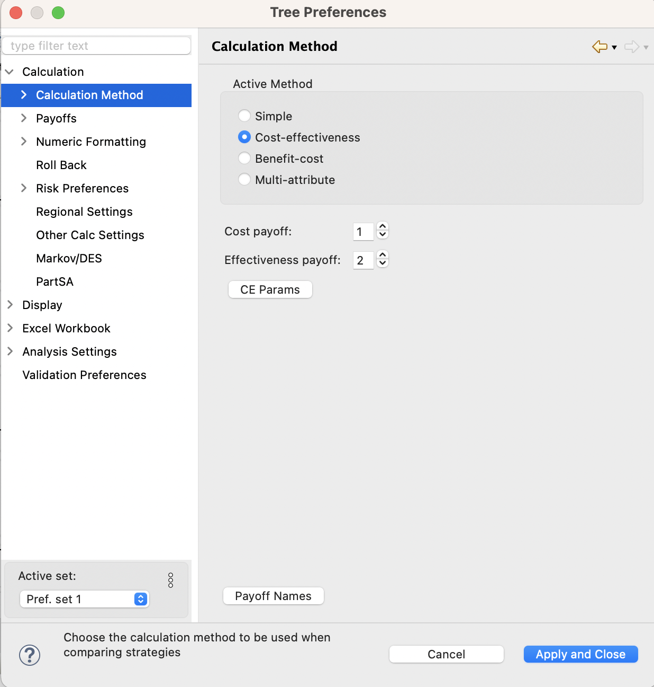
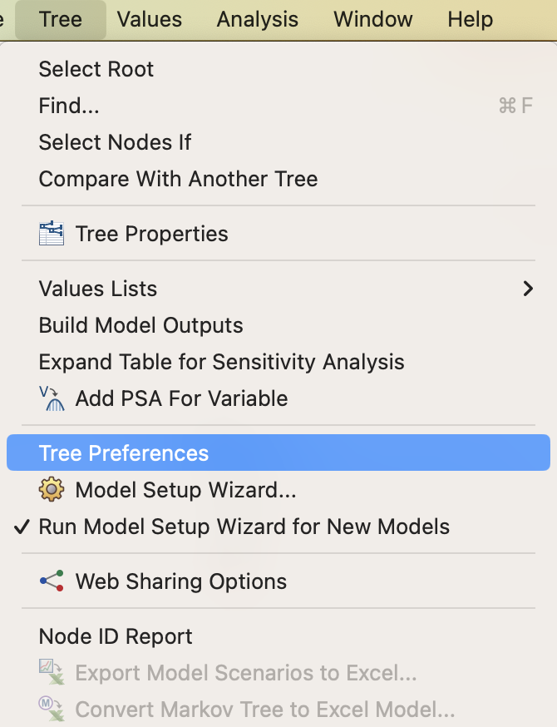
Tree Preferences
To compare strategies on the basis of cost-effectiveness
- Calculation Method: Cost-effectiveness
- Two active payoffs (cost and effectiveness)
- Willingness-to-Pay (WTP)

Slide 12
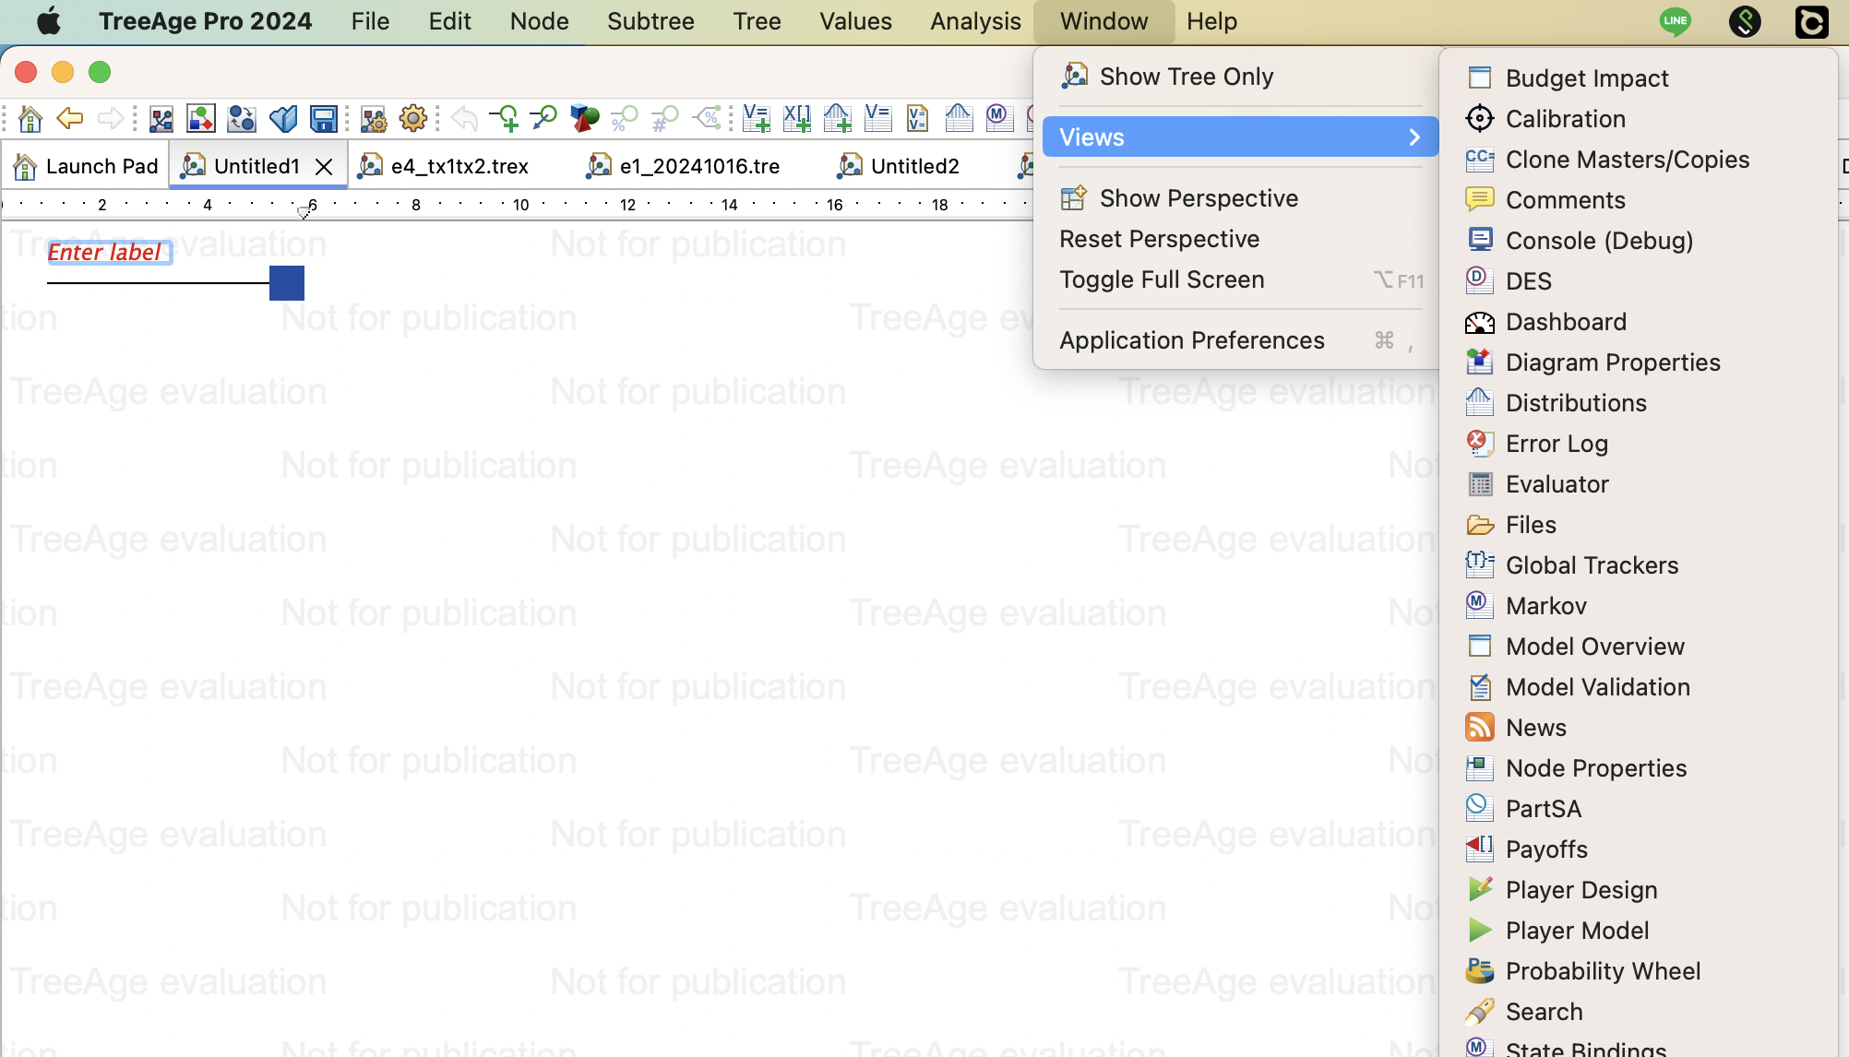
Views

Slide 13
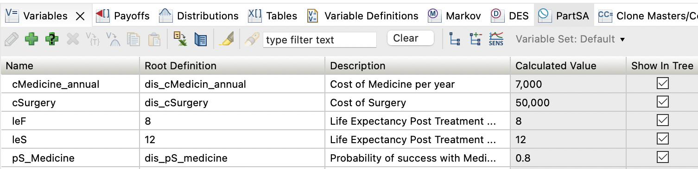
Variable Properties View
most numeric values should be entered as variables
variables assign a name to a numeric value (parameter) or a formula within the model variables
variables can then be referenced throughout the model to return the appropriate value

